Slide 1
Ch.8 Estimation (추정)
Updated: December 1st, 2016
Choi, Kwanghoon
Dept. of Electronics and Computer Engineering
Chonnam National University

Slide 2
This Lecture
Inferential Statistics(추측통계학)
Point Estimates (점추정)
Interval Estimates (구간추정)
Sample Size (샘플의 크기)

Slide 3
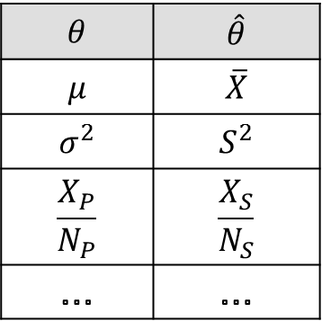

8.1 Point Estimates and Interval Estimates (점추정과 구간추정)
A point estimate(점추정) of an unknown parameter $θ$ is a statistic $\hat{θ}$ that represents a best guess at the value of $θ$.
$$θ$$ | $$\hat{θ}$$
$$μ$$ | $$\overline{X}$$
$$σ^{2}$$ | $$S^{2}$$
$$\frac{X_{P}}{N_{P}}$$ | $$\frac{X_{S}}{N_{S}}$$
… | …

Slide 4
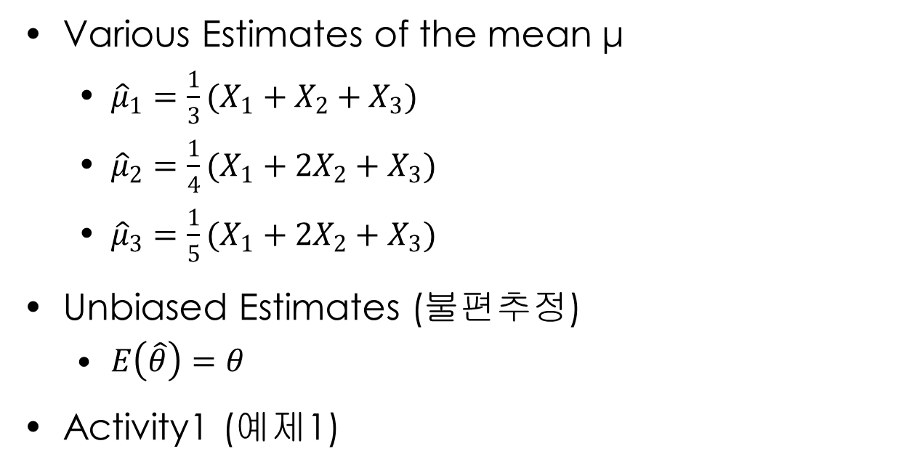
8.1 - Properties of Point Estimates
Various Estimates of the mean μ
${\hat{μ}}_{1}=\frac{1}{3}(X_{1}+X_{2}+X_{3})$
${\hat{μ}}_{2}=\frac{1}{4}(X_{1}+2X_{2}+X_{3})$
${\hat{μ}}_{3}=\frac{1}{5}(X_{1}+2X_{2}+X_{3})$
Unbiased Estimates (불편추정)
$E\left(\hat{θ}\right)=θ$
Activity1 (예제1)

Slide 5
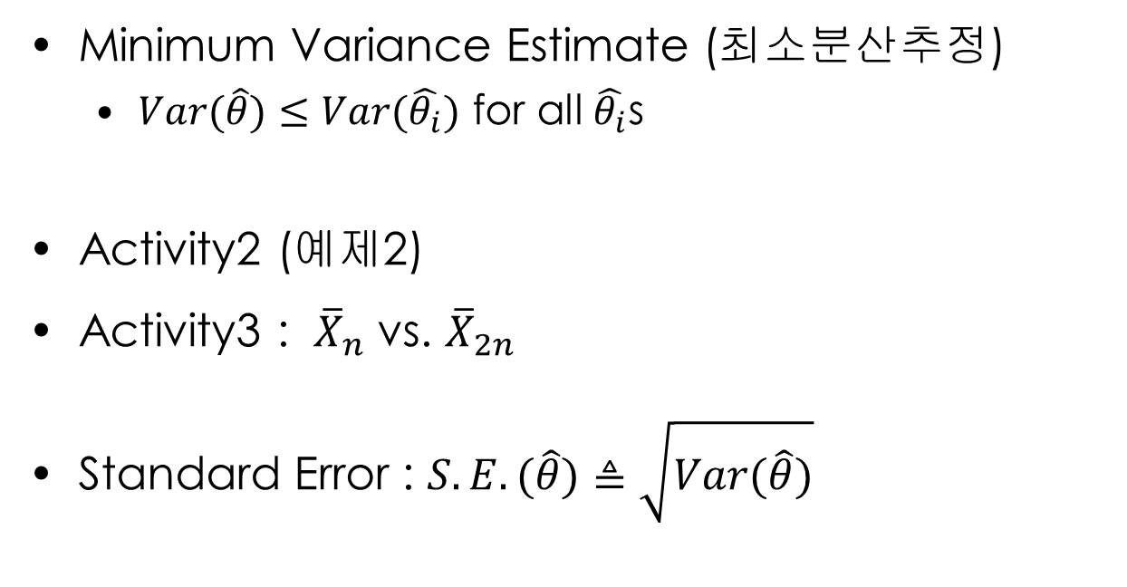
8.1 - Properties of Point Estimates
Minimum Variance Estimate (최소분산추정)
$Var(\hat{θ})≤Var(\hat{θ_{i}})$ for all $\hat{θ_{i}}$s
Activity2 (예제2)
Activity3 : ${\overline{X}}_{n}$ vs. ${\overline{X}}_{2n}$
Standard Error : $S.E.(\hat{θ})≜\sqrt{Var(\hat{θ})}$

Slide 6
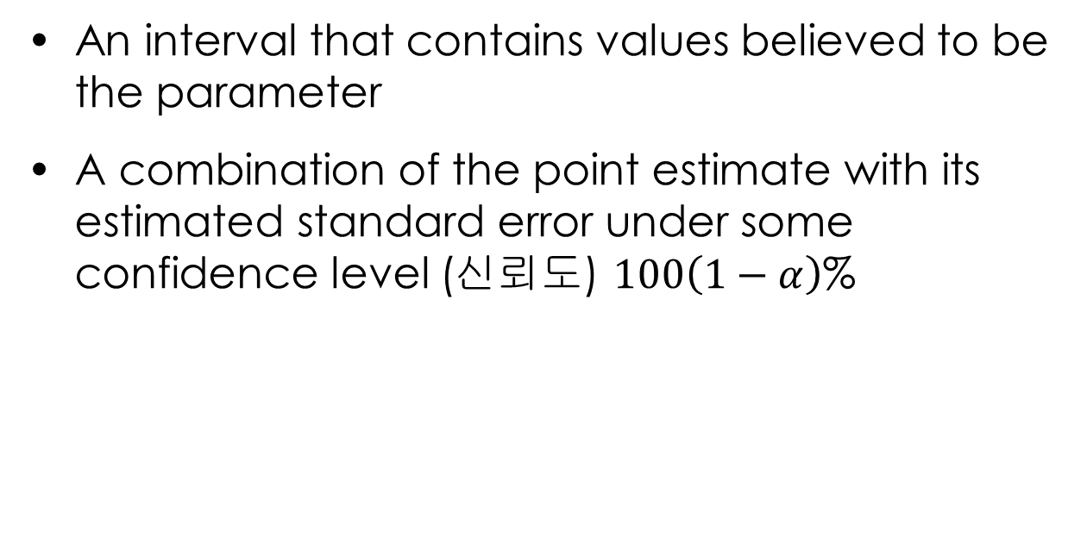
8.1 – Interval Estimates(구간 추정)
An interval that contains values believed to be the parameter
A combination of the point estimate with its estimated standard error under some confidence level (신뢰도) $100\left(1−α\right)$%

Slide 7
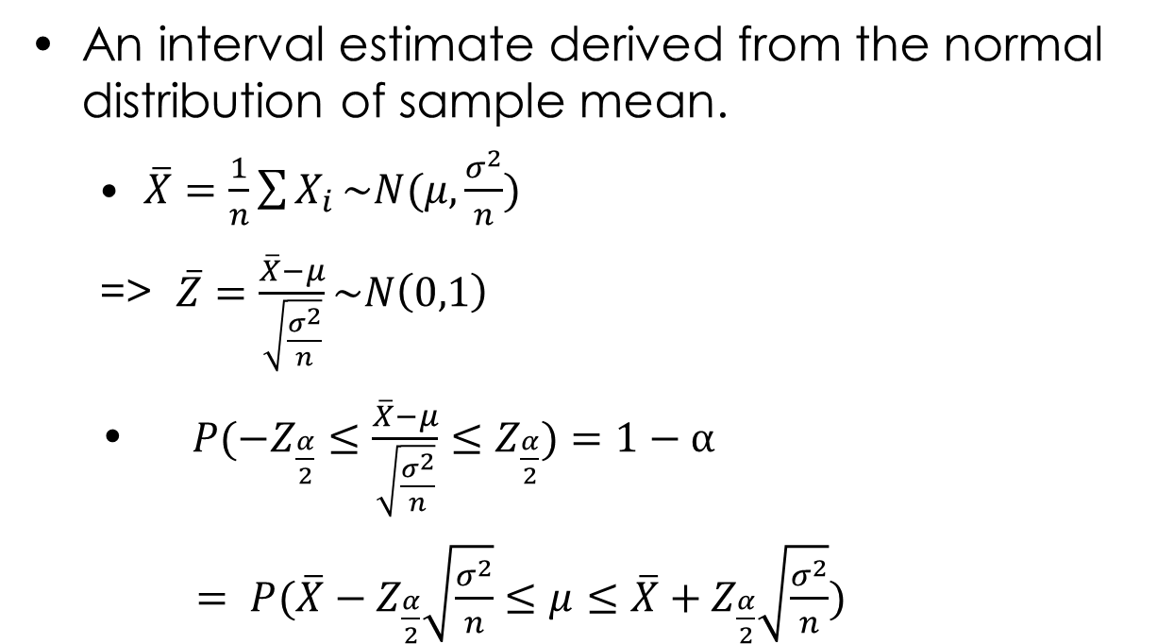
8.2 Interval Estimates of Population Mean (모평균의 구간추정)
An interval estimate derived from the normal distribution of sample mean.
$\overline{X}=\frac{1}{n}\sum{X_{i}}\sim N(μ,\frac{σ^{2}}{n})$
=> $\overline{Z}=\frac{\overline{X}−μ}{\sqrt{\frac{σ^{2}}{n}}}\sim N\left(0,1\right)$
$P(−Z_{\frac{α}{2}}≤\frac{\overline{X}−μ}{\sqrt{\frac{σ^{2}}{n}}}$ $≤Z_{\frac{α}{2}})=1−α$
$= P(\overline{X}−Z_{\frac{α}{2}}\sqrt{\frac{σ^{2}}{n}}≤μ≤\overline{X}+Z_{\frac{α}{2}}\sqrt{\frac{σ^{2}}{n}})$

Slide 8
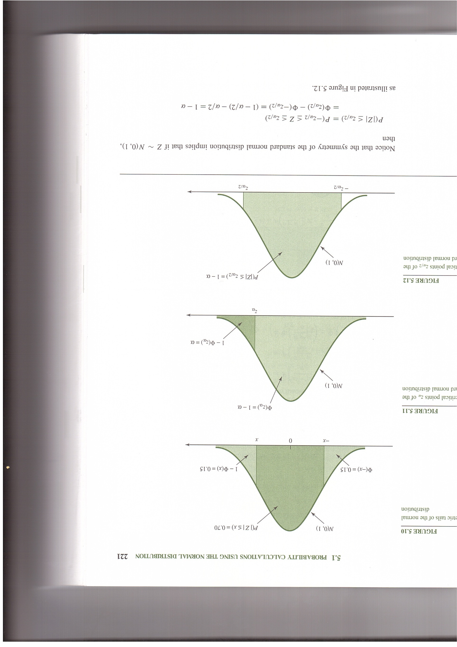
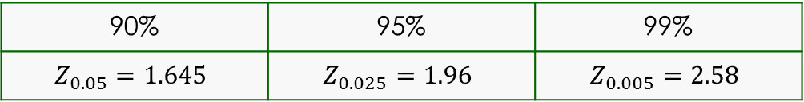

8.2 Interval Estimates of Population Mean (모평균의 구간추정)
$Z_{\frac{α}{2}}$ for degree of confidence $100\left(1−α\right)$%
90% | 95% | 99%
$$Z_{0.05}=1.645$$ | $$Z_{0.025}=1.96$$ | $$Z_{0.005}=2.58$$

Slide 9
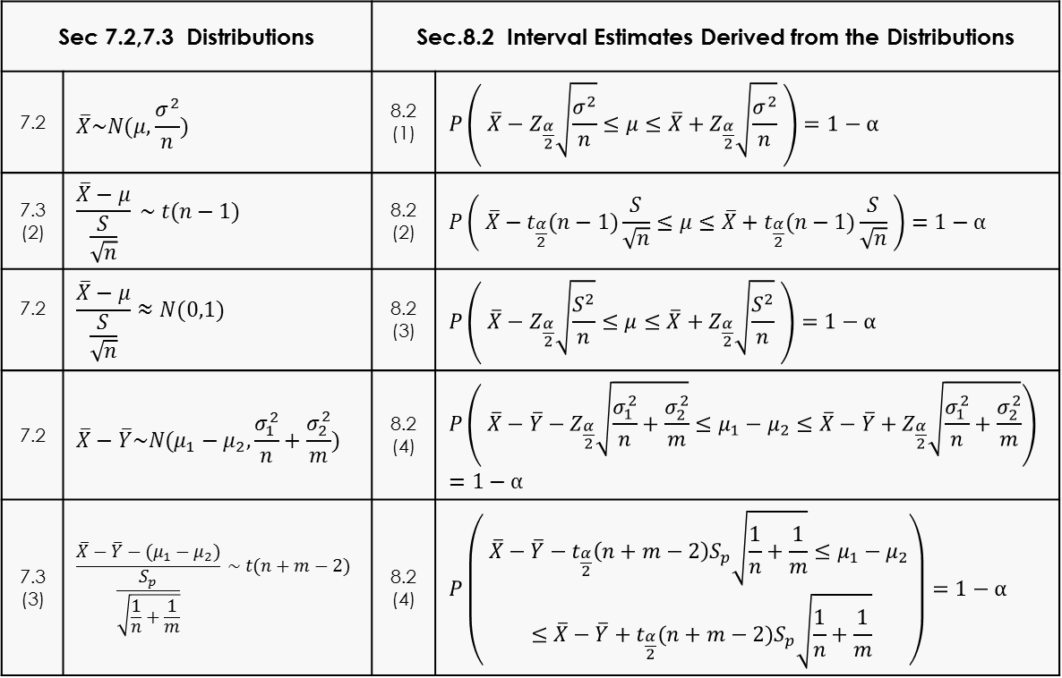
8.2 Interval Estimates of Population Mean (모평균의 구간추정)
Sec 7.2,7.3 Distributions |  | Sec.8.2 Interval Estimates Derived from the Distributions
7.2 | $$\overline{X}\sim N(μ,\frac{σ^{2}}{n})$$ | 8.2 (1) | $$P\left( \overline{X}−Z_{\frac{α}{2}}\sqrt{\frac{σ^{2}}{n}}≤μ≤\overline{X}+Z_{\frac{α}{2}}\sqrt{\frac{σ^{2}}{n}} \right)=1−α$$
7.3 (2) | $$\frac{\overline{X}−μ}{\frac{S}{\sqrt{n}}} \sim t(n−1)$$ | 8.2 (2) | $$P\left( \overline{X}−t_{\frac{α}{2}}(n−1)\frac{S}{\sqrt{n}}≤μ≤\overline{X}+t_{\frac{α}{2}}(n−1)\frac{S}{\sqrt{n}} \right)=1−α$$
7.2 | $$\frac{\overline{X}−μ}{\frac{S}{\sqrt{n}}}≈N(0,1)$$ | 8.2 (3) | $$P\left( \overline{X}−Z_{\frac{α}{2}}\sqrt{\frac{S^{2}}{n}}≤μ≤\overline{X}+Z_{\frac{α}{2}}\sqrt{\frac{S^{2}}{n}} \right)=1−α$$
7.2 | $$\overline{X}−\overline{Y}\sim N(μ_{1}−μ_{2},\frac{σ_{1}^{2}}{n}+\frac{σ_{2}^{2}}{m})$$ | 8.2 (4) | $$P\left( \overline{X}−\overline{Y}−Z_{\frac{α}{2}}\sqrt{\frac{σ_{1}^{2}}{n}+\frac{σ_{2}^{2}}{m}}≤μ_{1}−μ_{2}≤\overline{X}−\overline{Y}+Z_{\frac{α}{2}}\sqrt{\frac{σ_{1}^{2}}{n}+\frac{σ_{2}^{2}}{m}}\right)=1−α$$
7.3 (3) | $$\frac{\overline{X}−\overline{Y}−(μ_{1}−μ_{2})}{\frac{S_{p}}{\sqrt{\frac{1}{n}+\frac{1}{m}}}} \sim t(n+m−2)$$ | 8.2 (4) | $$P\left(\begin{aligned} \overline{X}−\overline{Y}−t_{\frac{α}{2}}\left(n+m−2\right)S_{p}\sqrt{\frac{1}{n}+\frac{1}{m}}≤μ_{1}−μ_{2} \\ ≤\overline{X}−\overline{Y}+t_{\frac{α}{2}}(n+m−2)S_{p}\sqrt{\frac{1}{n}+\frac{1}{m}}\end{aligned}\right)=1−α$$
Activity 1. Derive the interval estimate in Sec. 8.2 (2).

Slide 10
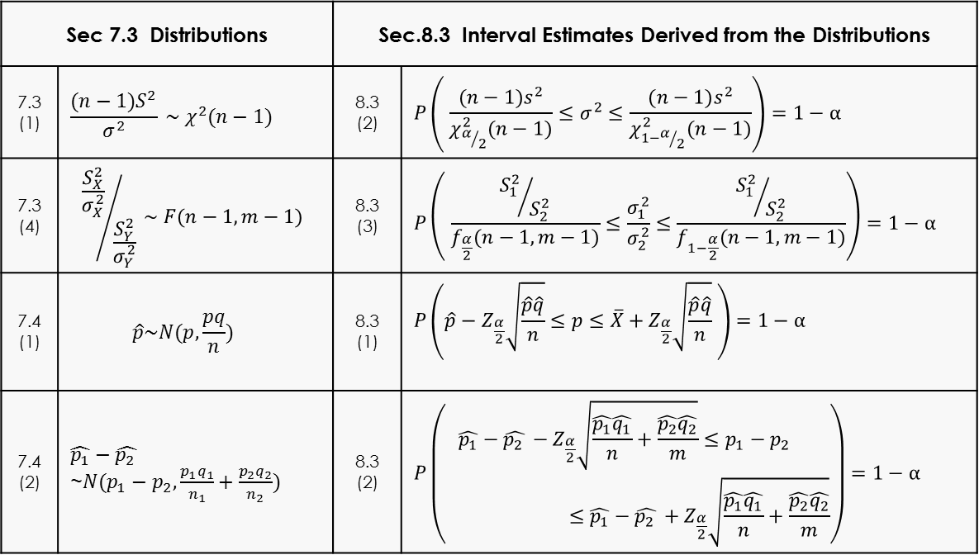
8.3 Interval Estimates of Population Proportion and Population Variance (모비율과 모분산의 구간추정)
Sec 7.3 Distributions |  | Sec.8.3 Interval Estimates Derived from the Distributions
7.3 (1) | $$\frac{(n−1)S^{2}}{σ^{2}} \sim χ^{2}(n−1)$$ | 8.3 (2) | $$P\left( \frac{(n−1)s^{2}}{χ_{α/2}^{2}(n−1)}≤σ^{2}≤\frac{(n−1)s^{2}}{χ_{1−α/2}^{2}(n−1)}\right)=1−α$$
7.3 (4) | $${\frac{S_{X}^{2}}{σ_{X}^{2}}}/{\frac{S_{Y}^{2}}{σ_{Y}^{2}}} \sim F(n−1,m−1)$$ | 8.3 (3) | $$P\left( \frac{{S_{1}^{2}}/{S_{2}^{2}}}{f_{\frac{α}{2}}(n−1,m−1)}≤\frac{σ_{1}^{2}}{σ_{2}^{2}}≤\frac{{S_{1}^{2}}/{S_{2}^{2}}}{f_{1−\frac{α}{2}}(n−1,m−1)}\right)=1−α$$
7.4 (1) | $$\hat{p}\sim N(p,\frac{pq}{n})$$ | 8.3 (1) | $$P\left(\hat{p}−Z_{\frac{α}{2}}\sqrt{\frac{\hat{p}\hat{q}}{n}}≤p≤\overline{X}+Z_{\frac{α}{2}}\sqrt{\frac{\hat{p}\hat{q}}{n}} \right)=1−α$$
7.4 (2) | $$\hat{p_{1}}−\hat{p_{2} }$$ ~$N(p_{1}−p_{2},\frac{p_{1}q_{1}}{n_{1}}+\frac{p_{2}q_{2}}{n_{2}})$ | 8.3 (2) | $$P\left(\begin{aligned}\hat{p_{1}}−\hat{p_{2} }−Z_{\frac{α}{2}}\sqrt{\frac{\hat{p_{1}}\hat{q_{1}}}{n}+\frac{\hat{p_{2}}\hat{q_{2}}}{m}}≤p_{1}−p_{2} \\ ≤\hat{p_{1}}−\hat{p_{2} }+Z_{\frac{α}{2}}\sqrt{\frac{\hat{p_{1}}\hat{q_{1}}}{n}+\frac{\hat{p_{2}}\hat{q_{2}}}{m}}\end{aligned}\right)=1−α$$
Activity 1. Derive the interval estimate in Sec. 8.3 (2).

Slide 11
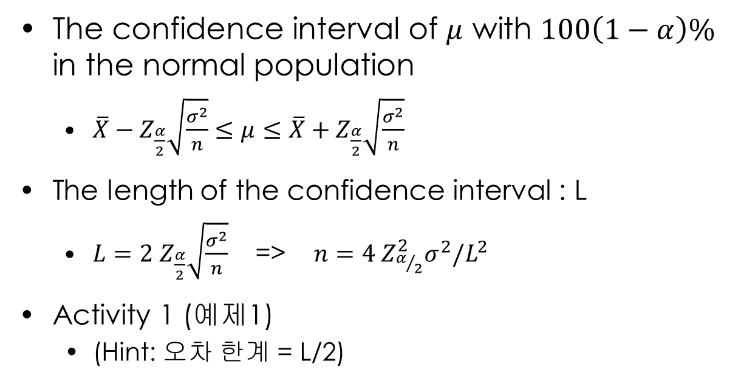
8.4 Sample Size (샘플크기)
The confidence interval of $μ$ with $100\left(1−α\right)\%$ in the normal population
$\overline{X}−Z_{\frac{α}{2}}\sqrt{\frac{σ^{2}}{n}}≤μ≤\overline{X}+Z_{\frac{α}{2}}\sqrt{\frac{σ^{2}}{n}}$
The length of the confidence interval : L
$L=2{ Z}_{\frac{α}{2}}\sqrt{\frac{σ^{2}}{n}}$ => $n=4{ Z}_{α/2}^{2}σ^{2}/L^{2}$
Activity 1 (예제1)
(Hint: 오차 한계 = L/2)

Slide 12
What we have learned
Two techniques of statistical inference
Point estimates
Interval estimates
The appropriateness of sample sizes

